Slide 1


Slide 2
Web Development
Web development refers to the building, creating, and maintaining of websites.
It includes aspects such as web design, web publishing, web programming, and database management.
It is the creation of an application that works over the internet i.e. websites.
The word Web Development is made up of two words, that is:
Web: It refers to websites, web pages or anything that works over the internet.
Development: Building the application from scratch.

Slide 3
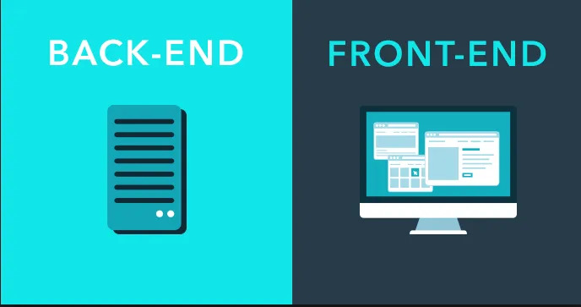

Slide 4
FRONT-END
The part of a website that the user interacts directly is termed as front end.
It is also referred to as the ‘client side’ of the application.
HTML, CSS and JavaScript for a website or Web Application so that a user can see and interact with them directly.
Backend is the server side of a website.
It is the part of the website that users cannot see and interact.
It is the portion of software that does not come in direct contact with the users.
It is used to store and arrange data.
BACK-END

Slide 5
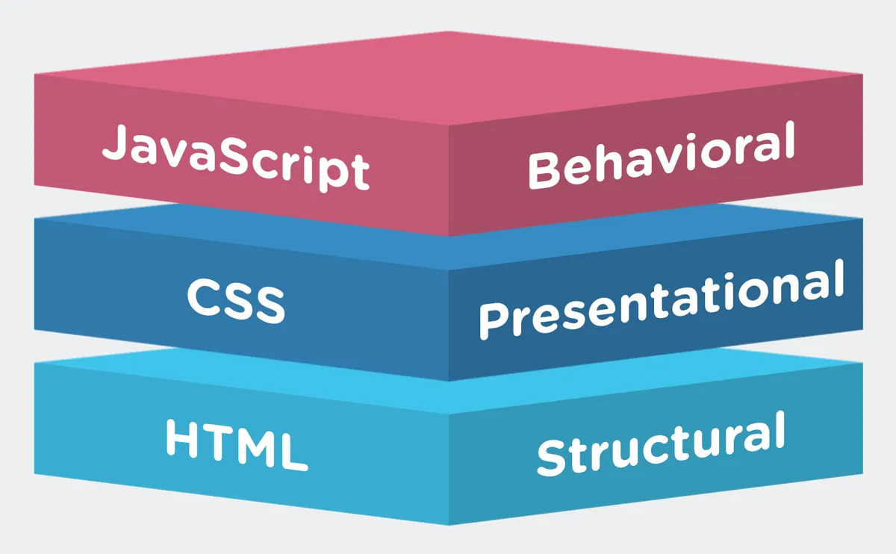
FRONT-END

Slide 6


Slide 7
HTML
HTML stands for Hyper Text Markup Language.
HTML is the standard markup language for creating Web pages.
HTML describes the structure of a Web page.
HTML consists of a series of elements.
HTML elements tell the browser how to display the content.
HTML elements label pieces of content such as "this is a heading", "this is a paragraph", "this is a link", etc.

Slide 8
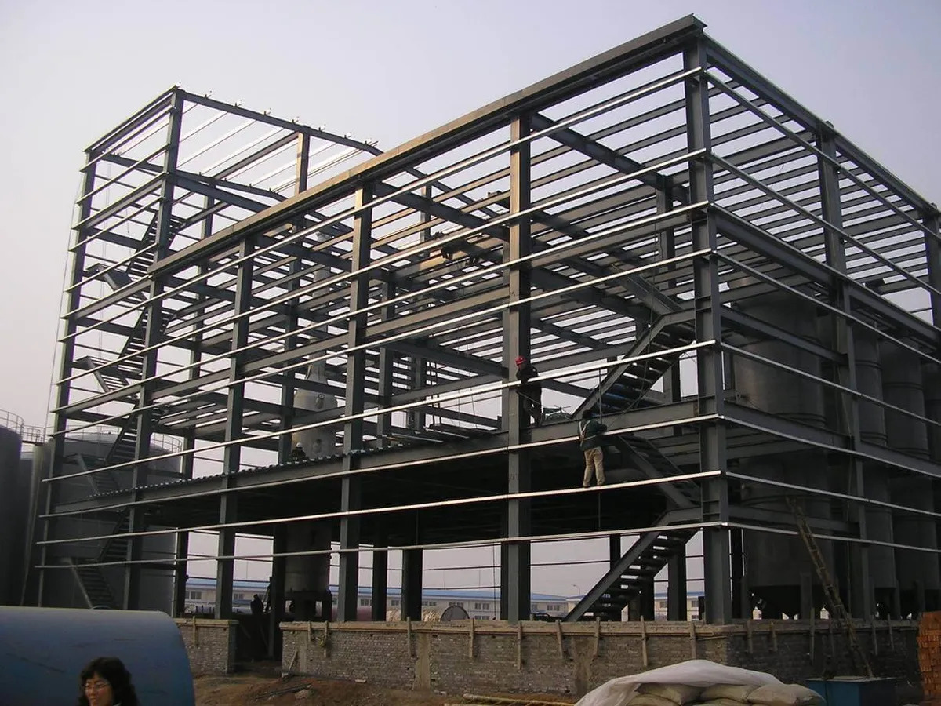
Example of HTML

Slide 9
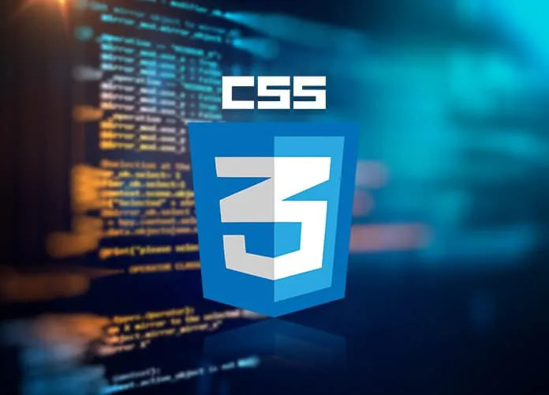

Slide 10
CSS
CSS is the language we use to style a Web page.
CSS stands for Cascading Style Sheets.
CSS describes how HTML elements are to be displayed on screen, paper, or in other media.
CSS saves a lot of work. It can control the layout of multiple web pages all at once.
External stylesheets are stored in CSS files.

Slide 11

Example of CSS

Slide 12


Slide 13
JAVASCRIPT
JavaScript is a dynamic programming language that's used for web development, in web applications, for game development, and lots more.
It allows you to implement dynamic features on web pages that cannot be done with only HTML and CSS.
Any time you see a click-to-show dropdown menu, extra content added to a page, and dynamically changing element colors on a page, to name a few features, you're seeing the effects of JavaScript.

Slide 14
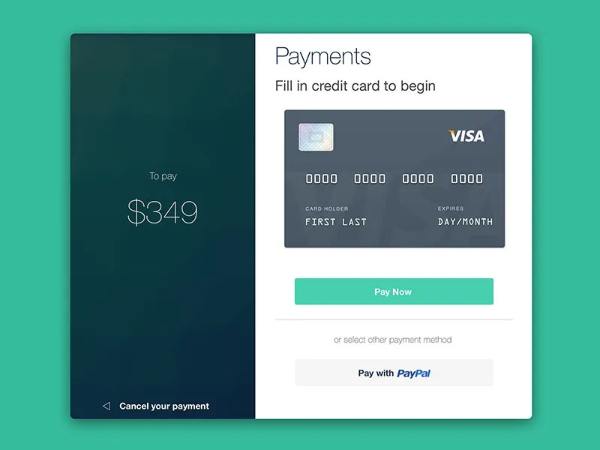
Example of JAVASCRIPT

Slide 15
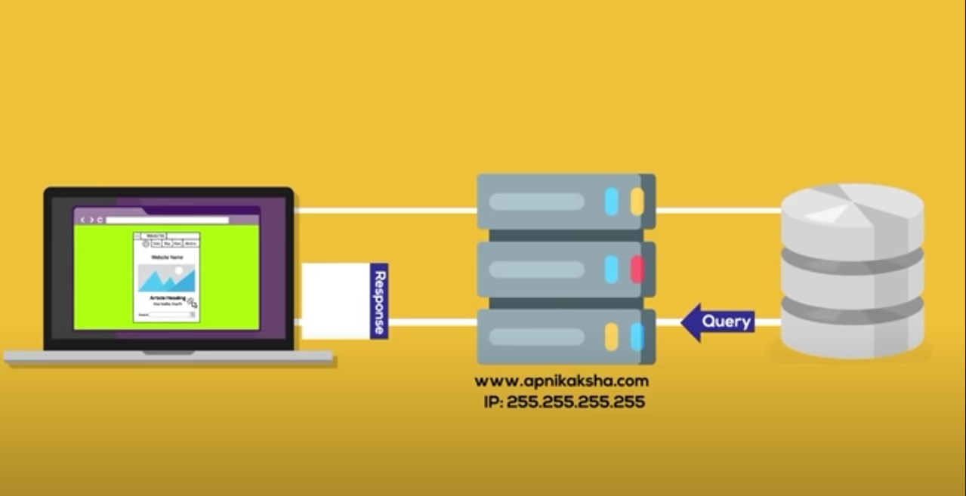
BACK-END
Database
Browser
Server

Slide 16


